Slide 1
Emergency Response System JishinSensa - 自信センサ
by:
Edvaldo Santos
Helio Nakazato
Hirley Dayan

Slide 2
OVERVIEW
Emergency response solution for detecting city disaster events based on sensor data and social network publications.

Slide 3
SOLUTION COMPONENTS
Hardware components of the solution:
1 Qualcomm Dragonboard 410c board
1 Arrow Linker Mezzanine Card Kit with:
1 temperature sensor
1 tilt sensor
And 1 LDR sensor

Slide 4
DRAGONBOARD WITH SENSORS

Slide 5
SOLUTION COMPONENTS
Platform components of the solution:
AWS IoT Platform
Twitter
Software components of the solution:
Linaro, CoreOS and Debian operating systems
Python services on the device and some backend services
NodeJS on thee Graphical User Interface

Slide 6
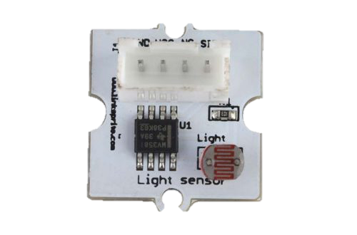


SOLUTION OVERVIEW

Slide 7
PROTOCOLS
API TweePy
HTTP
Linux processes
MQTT
MQTT
MQTT over WebSocket

Slide 8
PORTAL AND TWITTER SERVICES DOCKERNIZED COMPONENTS

Slide 9
APPLICATION DASHBOARD CARDS

Slide 10
APPLICATION DASHBOARD TWITTER EMERGENCY DETECTION WINDOW

Slide 11
APPLICATION DASHBOARD ON BROWSER WINDOW

Slide 12
APPLICATION DASHBOARD ON MOBILE SCREEN

Slide 13
GITHUB CODE
Code available in GitHub at: https://github.com/hirleydayan/ufscar/tree/master/CCS012/Final_Project
JishinSensa Instructable link: https://www.instructables.com/id/JishinSensa

